Slide 1
IREM: Cannabis and Real Estate
National Real Estate & Cannabis Summit
Peter Marcus, Communications Director
Terrapin

Slide 2

Peter Marcus
Communications Director
Terrapin
Peter Marcus is responsible for internal and external communications for Terrapin and also assists with universal messaging for the cannabis industry as a whole.
Prior to joining Terrapin, Peter served as the Senior Statehouse Reporter for the Colorado Springs Gazette and ColoradoPolitics.com, covering politics, the governor’s office, the Colorado Legislature, Congress, and federal, state and local governments.
The Washington Post twice named Peter one of the top state-based political and legislative reporters in the nation. He also has won over a dozen awards from the Colorado Press Association. In prior positions, Peter worked for the Colorado Statesman, a Denver-based political weekly, The Denver Daily News, and the Longmont Times-Call.

Slide 3
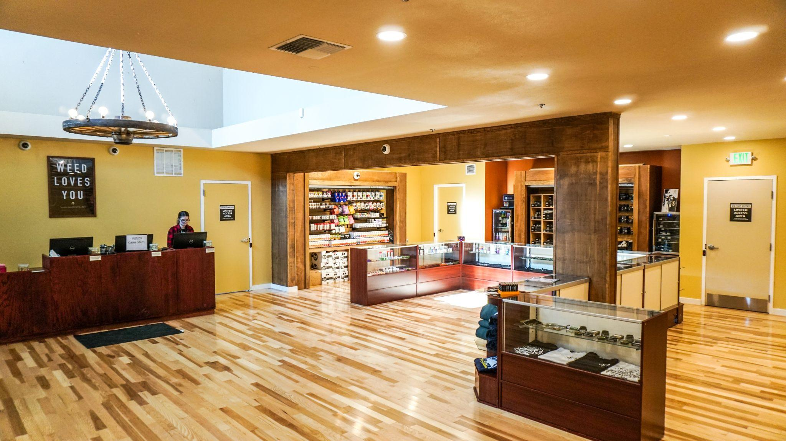
The Evolution of Cannabis Real Estate
Not all companies are equal
Finances
Taxes
Brand footprint
Compliance
Community impact
Growth strategy (Public or Private)
Rules and Regulations
Application process (Merit v Lottery)
CSR commitments/community impact
Zoning
Licensing requirements/renewals
Expansion of Services (Delivery/Hospitality)

Slide 4
Cannabis Real Estate: Concerns
Effects on crime rate
  Crime decreases slightly
  “...an additional dispensary in a neighborhood leads to a reduction of 17 crimes per month per 10,000 residents, which corresponds to roughly a 19 percent decline relative to the average crime (Regional Science and Urban Economics)
Property value increases 8.4 percent
  “...property values in the immediate vicinity of Denver’s retail marijuana establishments increased by more than eight percent since the law took effect on January 1, 2014.” (University of Wisconsin)
Nuisance (odor, noise, toxins)
Sustainability
Safety
COVID

Slide 5
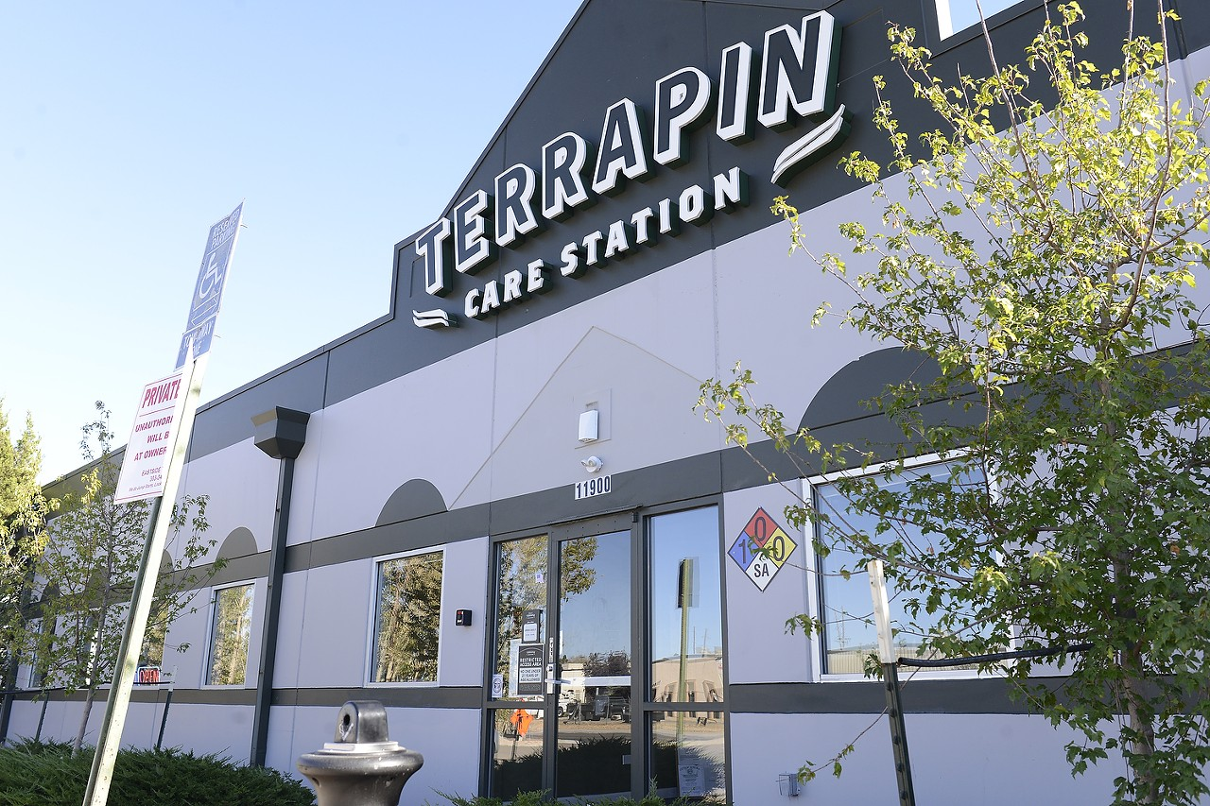
Cannabis Real Estate: Considerations
Value of the property manager, owner, or realtor
  Necessity for licensing
  Critical for community engagement/acceptance
  No property, no license
Advantages of leasing versus owning
  Control over your property
  Flexibility with regulators
  Streamlined construction/maintenance

Slide 6

Cannabis Real Estate: Moving Forward
Predictions
Relaxing of banking/taxes
Interstate compacts
Further consolidation

Slide 7


Cannabis Real Estate Myths
Cash-only industry
Larger MSOs are a safer bet
Marijuana is a contentious/controversial issue
Banking options are available
Responsible growth > a large company
“...of U.S. adults, 91% say that marijuana should be legal for medical and 60% say recreational” (Pew)

Slide 8
For inquiries, please reach out to:
pmarcus@terrapincarestation.com

